Slide 1
SMART WORKLOAD MANAGER
An Intelligent System for Monitoring and Managing Running Applications
TEAM DETAILS
2510030271 – Pavithra
2510030252 – Lathika
2510030305 – Snikitha
2510030174 - Anusha
Department
Computer Science & Engineering
Supervisor
Dr.Pavan Kumar Pagadala

Slide 2
THE PROBLEM
THE OBJECTIVE
From resource contention to safe workload decisions
Monitor real Linux processes
Measure CPU and memory usage
Calculate a workload score
Identify HIGH / MEDIUM / LOW workloads
Select a primary workload and generate safe recommendations
Record workload activity
STAGE | FLOW
Monitor | Linux processes-> monitoring
Analyze | analysis
Identify | decision
Recommend | recommendation
Log | logging
PRINCIPLE
Recommend actions instead of automatically terminating processes.
Background processes may consume high CPU or memory and affect an important running workload.
02

Slide 3
ARCHITECTURE / FLOW
Monitor → Analyze → Identify → Recommend → Log
01
02
03
04
05
Monitor
Analyze
Identify
Recommend
Log
Read real Linux process information
Check CPU and memory usage
Calculate a score and classify the workload
Suggest KEEP, MONITOR, REVIEW, or PROTECT
Store activity and workload information
IMPLEMENTATION PATH
Linux /proc provides process data. C and system calls connect monitoring, workload execution, communication, synchronization, and logging.
03

Slide 4
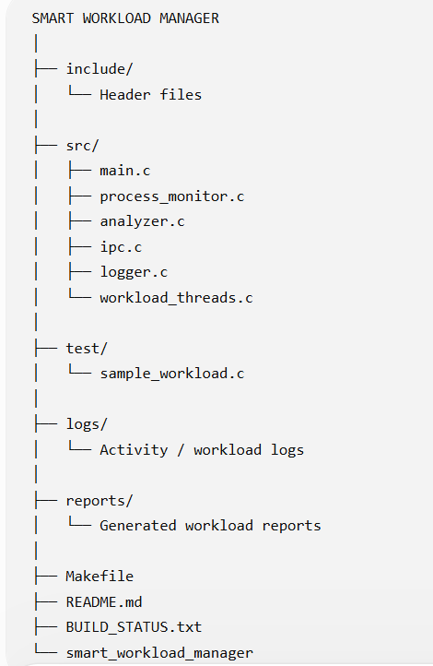
Technical competence
OS concept | How it is used
Linux /proc | Process and resource monitoring
Processes | Running workload identification
fork() | Creates a sample workload process
exec / execl() | Executes the sample workload
waitpid() | Process synchronization where required
OS concept | How it is used
pipe() | IPC support
pthread | Concurrent workload functionality
mutex | Thread-safe operations and logging
File I/O | Activity logs and workload reports
System calls | Communication with the Linux OS
04

Slide 5
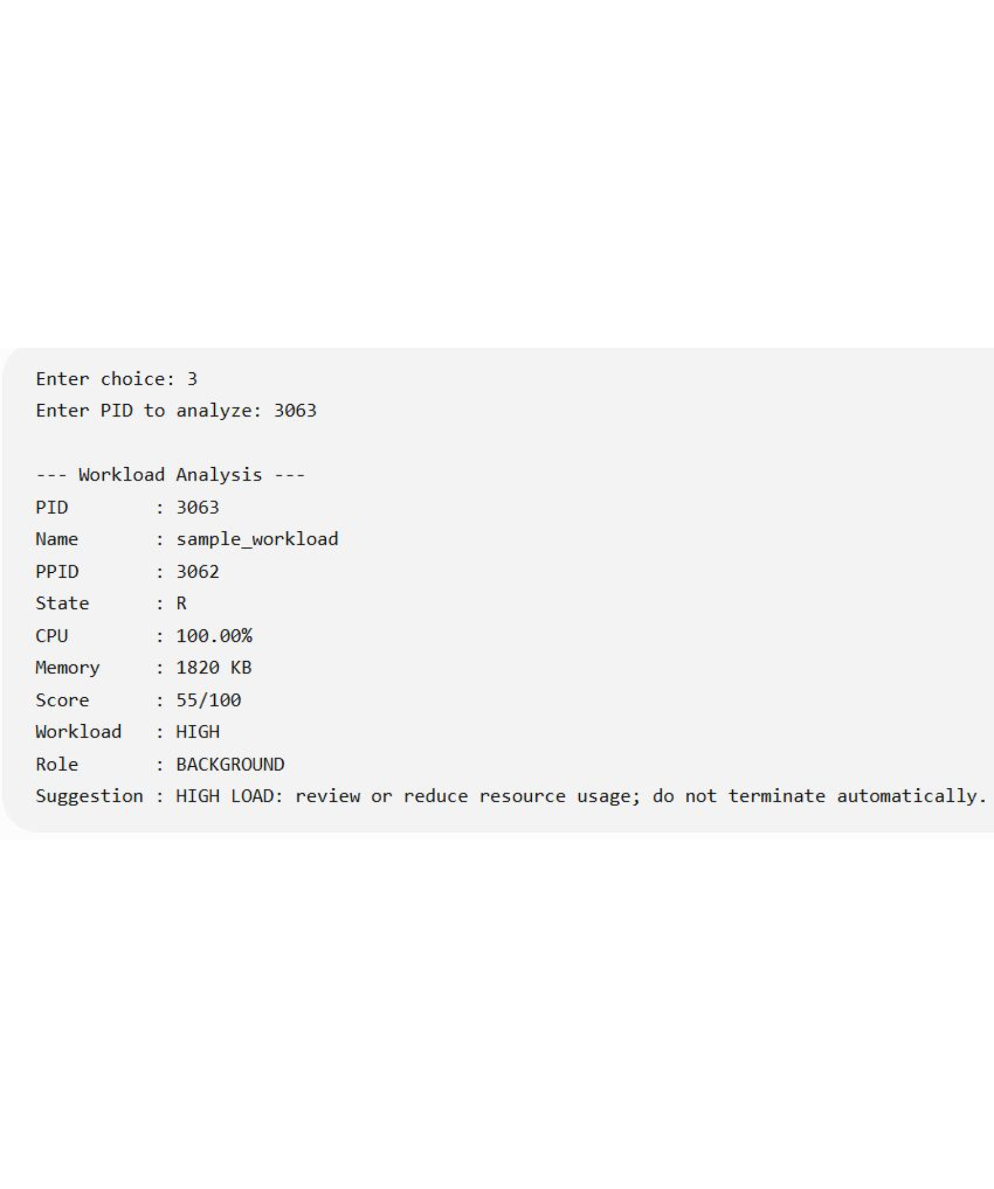
High-load workload detection
PID: 3063 · Name: sample_workload · State: R · CPU: 100.00% · Memory: 1820 KB · Score: 55/100 · Workload: HIGH · Role: BACKGROUND
100% CPU
55/100 score
Measured resource use
Quantitative result
HIGH load
BACKGROUND role
Classification
Workload context
Result: a real CPU-intensive workload was detected and classified.
05

Slide 6
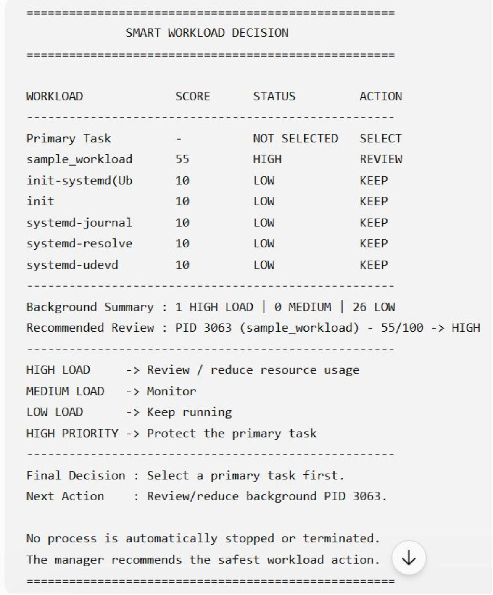
OUTCOME 2 · SAFE DECISION
High load becomes REVIEW, not termination
WORKLOAD | SCORE | STATUS | ACTION
sample_workload | 55 | HIGH | REVIEW
systemd | 10 | LOW | KEEP
init | 10 | LOW | KEEP
systemd-journal | 10 | LOW | KEEP
SAFETY RULE
No process is automatically stopped or terminated.
HIGH LOAD → review / reduce usage · MEDIUM → monitor · LOW → keep running
06

Slide 7
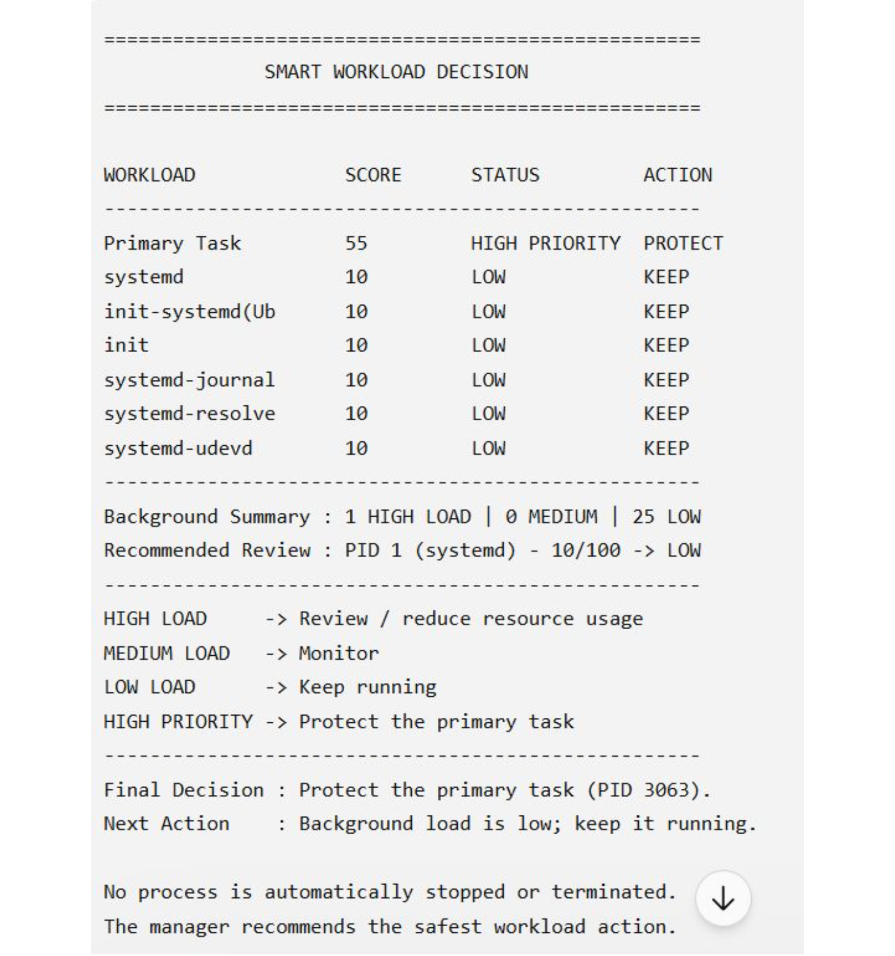
EVIDENCE PLACEHOLDER
Primary workload protection
PID 3063 is selected as the primary workload.
PROTECT
REVIEW
Primary task
Background role
score 55 · HIGH PRIORITY
55/100 → HIGH
Primary role: 55/100 → HIGH PRIORITY → PROTECT
Main novelty: the same resource condition produces a different recommendation based on workload importance.
07

Slide 8
ACCURACY OF RESULTS
Accuracy of results is demonstrated by actual output
METRIC | OBSERVED RESULT | INTERPRETATION
CPU usage | 100% | High CPU workload detected
Memory | 1820 KB | Resource usage measured
Workload score | 55/100 | Quantitative evaluation generated
Classification | HIGH | High-load workload identified
Role | BACKGROUND | Background workload identified
Recommendation | REVIEW | Safe action generated
Primary role | HIGH PRIORITY | Important workload protected
Proof chain: CPU → score → classification → action
Evaluation is based on actual program output, not only source-code claims.
08

Slide 9
RUBRIC ALIGNMENT
Innovation, sustainability, and utility
INNOVATION
SUSTAINABILITY
UTILITY TO SOCIETY
Role-aware workload decisions
Resource usage combined with workload importance
Recommendation-based management without blind termination
Lightweight, modular C/Linux implementation
Works with different running processes
Extendable to adaptive thresholds and historical analysis
Helps identify resource-heavy processes
Can improve responsiveness on resource-constrained systems
Useful for computer labs and shared systems
Provides understandable workload recommendations
09

Slide 10
FINAL OUTCOME
Final outcome: one workload, two safe actions
REAL LINUX PROCESS → CPU / MEMORY MONITORING → 55/100 SCORE → HIGH WORKLOAD → ROLE IDENTIFICATION
BACKGROUND → REVIEW
Review or reduce resource usage.
PRIMARY → PROTECT
Protect the important workload.
Real Linux processes monitored
High CPU workload detected successfully
Workload score and classification generated
Role-aware recommendation and primary protection demonstrated
Smart Workload Manager provides a practical OS-level approach for monitoring workloads and recommending safe actions while protecting important processes.
Future scope: historical workload trends · alerts · GUI dashboard · adaptive thresholds · ML-based workload prediction
Thank you · Questions?
10

